Slide 1


The American Express Campus Challenge 2024
Data Titans
Pritish Saha, Adrij Das, Rounak Nath
(Indian Institute of Technology Kharagpur)

Slide 2
SUMMARY OF THE FINAL SOLUTION
Objective Function/Dependent Variable
Sampling
Feature Engineering
Modeling Technique
Any other Dimension?
We reviewed the following modeling techniques:
XGBoost
CatBoost
Gradient Boosting Machine (GBM)
LightGBM
XGBoost was selected as the final solution based on achieving the highest accuracy metric of 65% after hyperparameter optimization using Bayesian Optimization and Grid Search CV.
Detailed preprocessing and feature engineering steps.
Robust model evaluation using cross-validation and hyperparameter tuning.
Applied rigorous parameter tuning using Bayesian optimization to achieve optimal model performance.
Objective:
To predict the winning team in T20 matches.
Dependent Variable:
Created the ‘winner_01' variable to indicate the winning team (0 for team1 and 1 for team2).
Performed the following major feature engineering steps:
Created features like team_avg_Econ_last10, team_srrate_ratio_last10, team_runs_ratio_last10, percentage_dot_balls_bowled_last_5, etc.
Used mutual information and VIF for feature selection to identify key features.
Stratified Sampling was used to ensure balanced representation of matches won by different teams.
Summary
Model Performance
Model Details
Feature Engineering
Sampling Technique
Improvment Potential

Slide 3
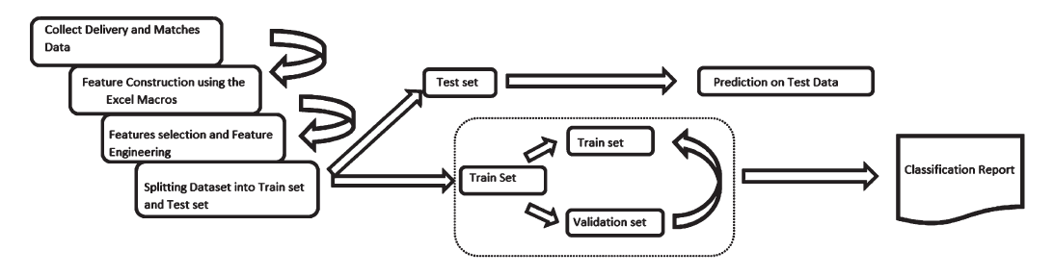

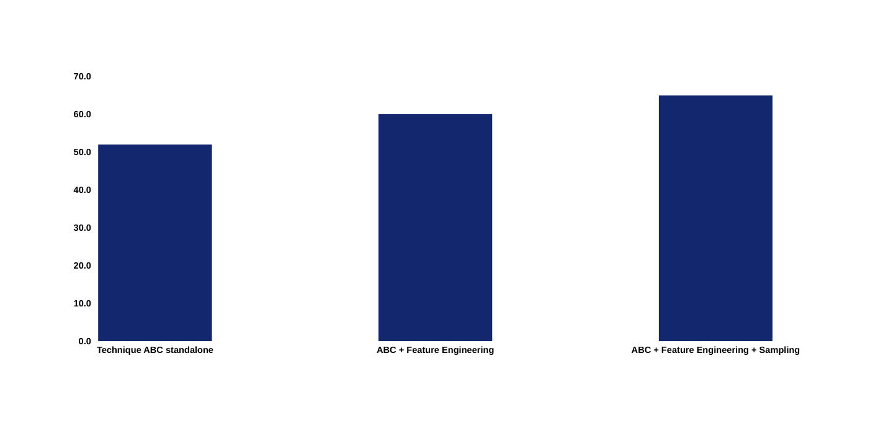
MODEL PERFORMANCE – ALL ITERATIONS
Accuracy
[Out of Sample/Validation Results]
Accuracy
[Out of Sample/Validation Results]
Iteration 3 led to a significant jump in accuracy from 52% to 65% due to optimized feature engineering and hyperparameter tuning.
XGBoost outperformed other models consistently.
Summary
Model Performance
Model Details
Feature Engineering
Sampling Technique
Improvment Potential

Slide 4
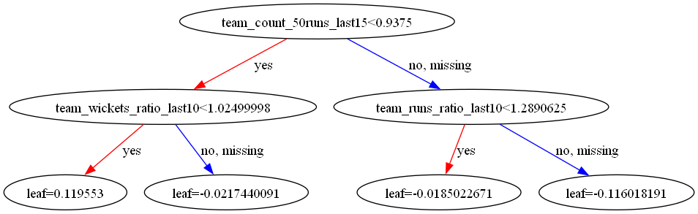
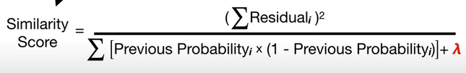
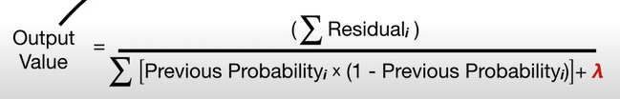


MODEL TECHNIQUE/ALGORITHM DETAILS
XGBoost gave best R1 accuracy score and was used as final modeling technique in Round 2
Detailed overview of the Modeling Technique
Chosen Model: XGBoost
Why XGBoost:
High predictive accuracy and robustness to overfitting.
Efficient handling of large datasets and missing values.
Objective Function: Binary cross-entropy loss for binary classification as it measures the performance of a classification model whose output is a probability value between 0 and 1.
Created the dependent variable as the probability of winning based on match outcomes.
Inner Workings:
Model Architecture: Gradient boosting framework with decision trees as base learners.
Model Equation: Aggregation of weighted predictions from individual trees.
Real-World Example: XGBoost has been used in various Kaggle competitions, often outperforming other algorithms due to its efficiency and performance.
Academic Literature: Referenced in numerous research papers for its efficiency and performance.
XGBoost Inner Workings
Summary
Model Performance
Model Details
Feature Engineering
Sampling Technique
Improvment Potential

Slide 5
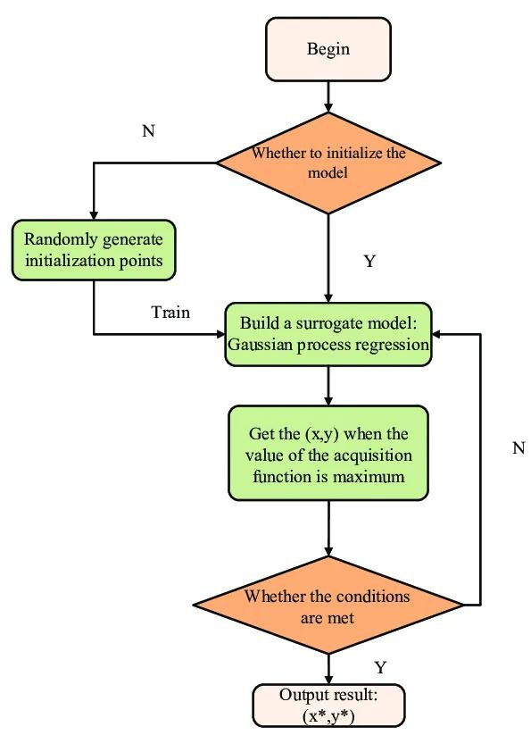
MODEL TECHNIQUE/ALGORITHM DETAILS
Basic flowchart of Bayesian Optimization
Techniques Tried: We experimented with both CatBoost and XGBoost to identify the best-performing model for our dataset.
Hyperparameter Tuning:
XGBoost: Utilized Bayesian Optimization and GridSearchCV to find the optimal hyperparameters, ensuring the best possible model performance.
CatBoost: Employed RandomizedSearchCV to tune hyperparameters, allowing for a thorough exploration of the parameter space in a computationally efficient manner.
Performance and Selection: After extensive experimentation, XGBoost provided the best R1 accuracy score and was selected as the final modeling technique in Round 2 due to its consistent performance and robustness.
Bayesian Optimization for XGBoost:
Focused on optimizing key hyperparameters such as learning rate, max depth, and subsample ratio.
This iterative approach helped in efficiently navigating the hyperparameter space, leading to improved model accuracy and generalization.
GridSearchCV for XGBoost:
Conducted an exhaustive search over specified parameter values for the XGBoost model.
Enabled the identification of the best combination of hyperparameters by evaluating the model's performance on the validation set.
RandomizedSearchCV for CatBoost:
Implemented a randomized search strategy over hyperparameters to quickly identify promising configurations.
Balanced exploration and exploitation by sampling a wide range of hyperparameter values.
Summary
Model Performance
Model Details
Feature Engineering
Sampling Technique
Improvment Potential

Slide 6
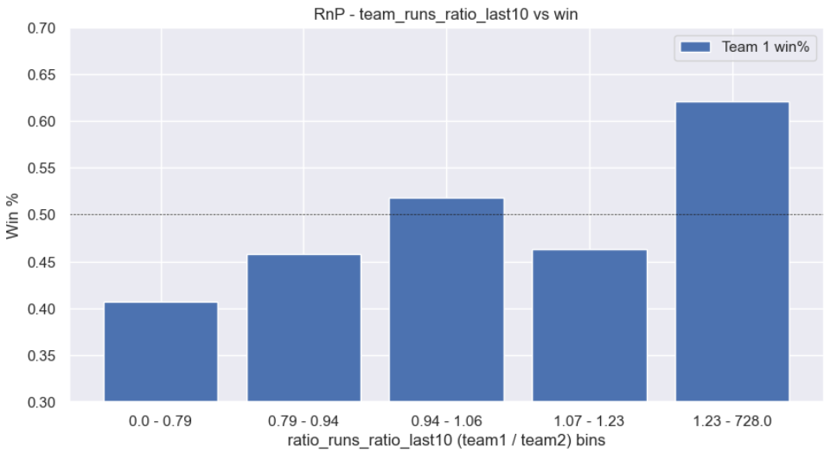
FEATURE ENGINEERING & SELECTION
We used a combination of Mutual Information (MI) and Variance Inflation Factor (VIF) for selecting relevant features. This approach helped us identify the most informative and non-collinear features for our model.
Mutual Information: Assessed the mutual dependence between features and the target variable, helping to identify features with the most predictive power.
Variance Inflation Factor (VIF): Used to detect and mitigate multicollinearity among features, ensuring that the features selected are not highly correlated with each other.
The following features were created/engineered …
S. No. | Feature Description
1 | team_avg_Econ_last10
2 | .team_srrate_ratio_last10
3 | team_runs_ratio_last10
4 | percentage_dot_balls_bowled_last_5
5 | pitch condition
6 | team_wickets_ratio_last10
7 | percentage_runs_through_boundaries_last_5_ratio
8 | team_avg_econ_ratio_last10
9 | runs_through_extras_last_5_ratio
10 | bowling_srrate_ratio_last_10
11 | weighted wins
12 | day_night_match
13 | batting_bowling_win_ratio
14 | ratio_avg_runs_last15
Some good Feature Trends
Summary
Model Performance
Model Details
Feature Engineering
Sampling Technique
Improvment Potential

Slide 7
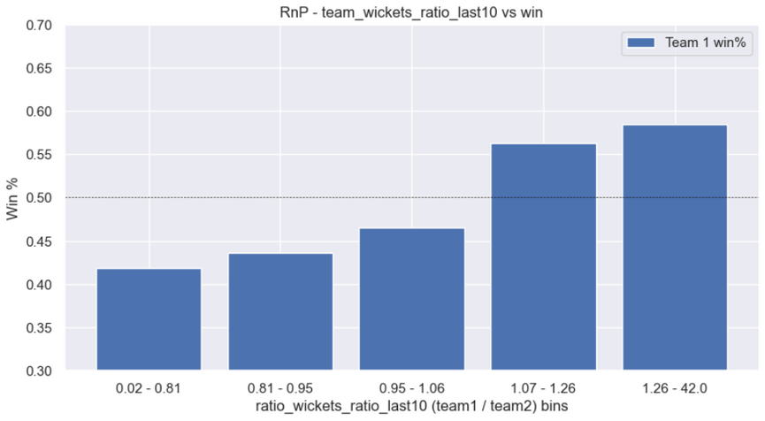
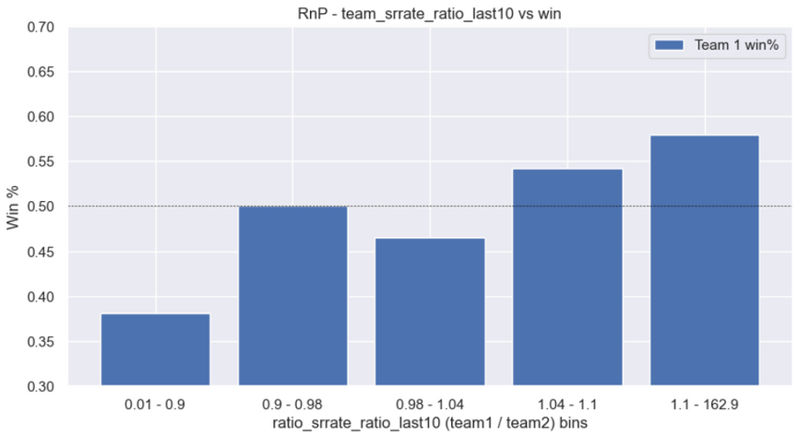
FEATURE ENGINEERING & SELECTION
Some good Feature Trends
Top 10 Features in the Final Solution
Rank | Feature | Imp
1 | team_count_50runs_last15 | 18.4%
2 | team_runs_ratio_last10 | 14.7%
3 | team_wickets_ratio_last10 | 12.5%
4 | team_srrate_ratio_last10 | 12.0%
5 | bowling_srrate_ratio_last_10 | 10.8%
6 | ratio_avg_runs_last15 | 9.1%
7 | team_winp_last5 | 9.0%
8 | weighted wins | 6.7%
9 | ground_avg_runs_last15 | 6.6%
10 | team1_winp_team2_last15 | 0.0%
Summary
Model Performance
Model Details
Feature Engineering
Sampling Technique
Improvment Potential

Slide 8
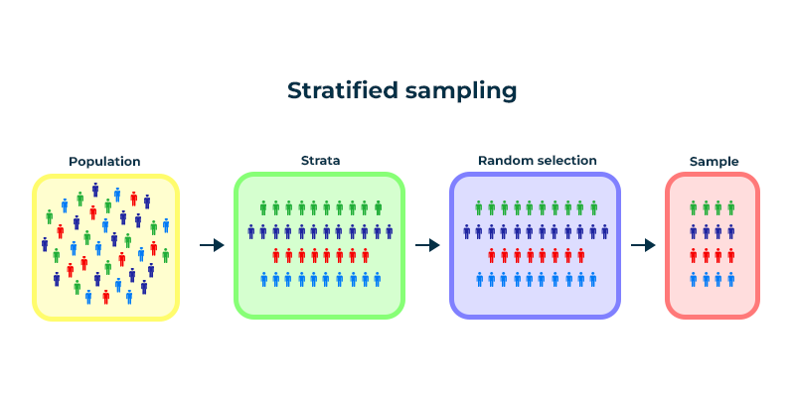
SAMPLING TECHNIQUE USED
Detailed overview of the Sampling Technique
Stratified Sampling was employed to maintain the distribution of match outcomes across training, feature selection, and testing sets. This ensured that each subset accurately represented the overall dataset, leading to reliable model evaluation and improved performance stability.
Why Stratified Sampling Was Used:
Maintaining Class Distribution: Preserved original distribution of match outcomes (win/loss).
Reliable Model Evaluation: Ensured evaluation metrics reflected true performance.
Improved Model Generalization: Enhanced model's robustness to unseen data.
Impact:
Row Count: Total rows unchanged; balanced class representation in subsets.
Event Rate: Consistent win/loss proportion across all subsets.
Benefits:
Improved Generalization: Better performance on both training and validation data.
Performance Stability: Reduced overfitting/underfitting risks.
Reliable Metrics: Accurate reflection of model’s accuracy and performance.
Conclusion:
Stratified sampling was crucial for maintaining dataset integrity, ensuring reliable evaluation, and enhancing model stability and accuracy.
Summary
Model Performance
Model Details
Feature Engineering
Sampling Technique
Improvment Potential

Slide 9
MORE POTENTIAL TO IMPROVE
Incorporate advanced ensemble techniques like Stacked Generalization and Voting Classifiers.
Experiment with neural network architectures, including various LSTM and GRU configurations.
Explore temporal models for capturing sequential patterns.
Advanced hyperparameter tuning using Bayesian Optimization and Tree-structured Parzen Estimator (TPE).
1
ML Enhancements
Introduce advanced features such as player-specific performance metrics, weather, and pitch conditions.
Perform deeper statistical analysis to uncover hidden patterns.
Utilize external datasets for enriched feature set.
Implement SMOTE and Tomek Links for balancing class distribution and improving model robustness.
2
Feature Engineering
3
Implement real-time data processing for live match prediction.
Intelligent feature engineering based on live data and ongoing match conditions.
Any other dimension?
Model prediction
Summary
Model Performance
Model Details
Feature Engineering
Sampling Technique
Improvment Potential

Slide 10

Thank You!
Data Titans

